Slide 1

Welcome
@RudolfVesely

Slide 2
PowerShell & Pester
@RudolfVesely

Slide 3
About Me
I am Rudolf Vesely
Rackspace
Azure Solutions Architect
Certifications
MCSD: Azure Solutions Architect
5x MCSE & MCITP: EA
ITIL v3 & TOGAF v9.1
@RudolfVesely

Slide 4
About Me
PowerShell
I’m former dev
Blogger on https://techstronghold.com
Blogger on Hey, Scripting Guy! Blog
Tweet to me ;-)
Twitter: @RudolfVesely
PowerShell User Group (#PSUG)
On Thursday
HPH5 Client Hub
6 PM – 9 PM
@RudolfVesely

Slide 5
Agenda
Intro
Pester
End
We are here
@RudolfVesely

Slide 6
What is Unit testing?
@RudolfVesely

Slide 7
What is Unit testing?
Better question:
How to test software?
@RudolfVesely

Slide 8

Software testing: Testing levels
@RudolfVesely

Slide 9
Software testing: Testing levels
Unit testing
Verify the functionality of a specific section of code
Integration testing
Test interaction between integrated components
Component interface testing
Check handling of data between various components
Beyond full integration testing
@RudolfVesely

Slide 10
Software testing: Testing levels
System testing
End-to-end testing
@RudolfVesely

Slide 11

Software testing: Testing levels
System testing
End-to-end testing
@RudolfVesely

Slide 12
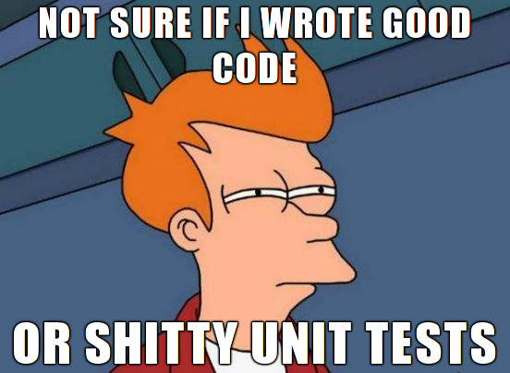
Unit testing: Benefits
Finds problems early (the development cycle)
Finds problems fast
Facilitates change
@RudolfVesely

Slide 13
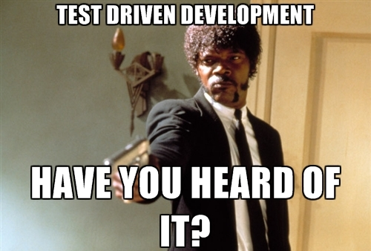
Another term: TDD
Test-driven development (TDD)
Related to the test-first programming concepts
Unit tests are created before the code itself is written
@RudolfVesely

Slide 14

Wait a second…
Do we need it for PowerShell?
@RudolfVesely

Slide 15
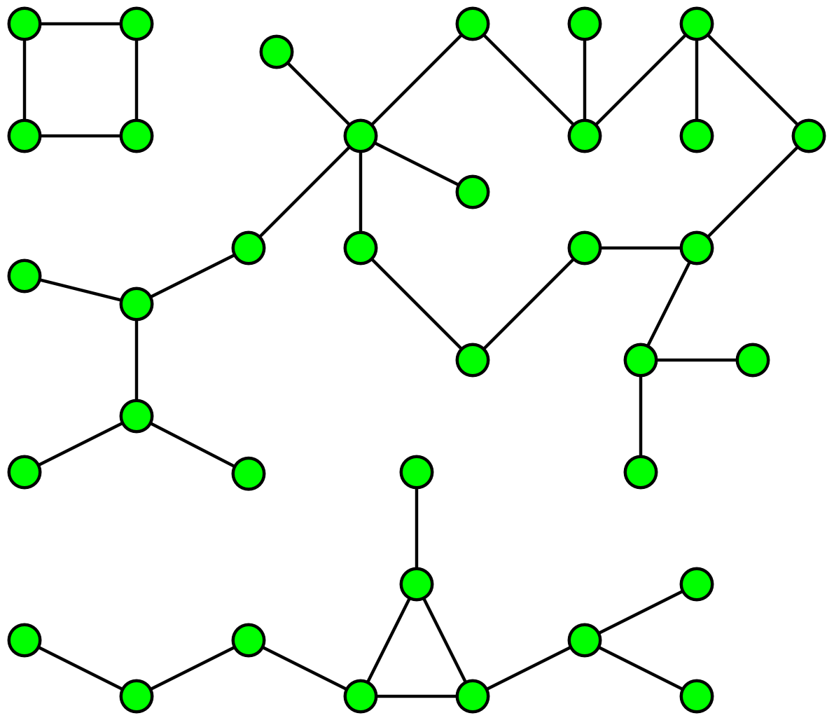
Interaction failure
@RudolfVesely

Slide 16
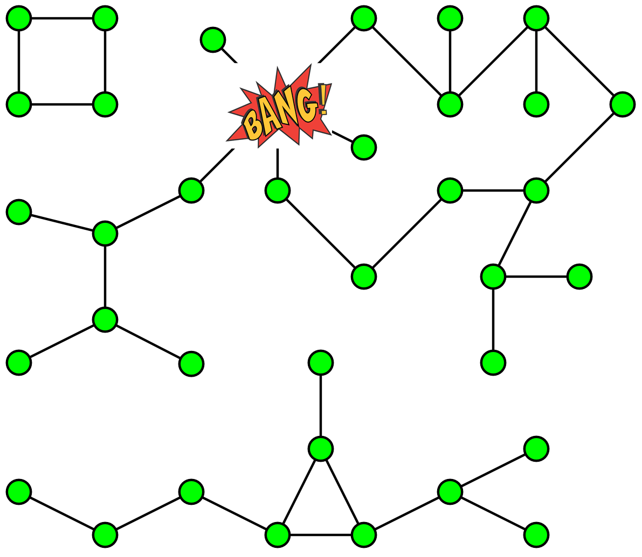
Interaction failure
@RudolfVesely

Slide 17
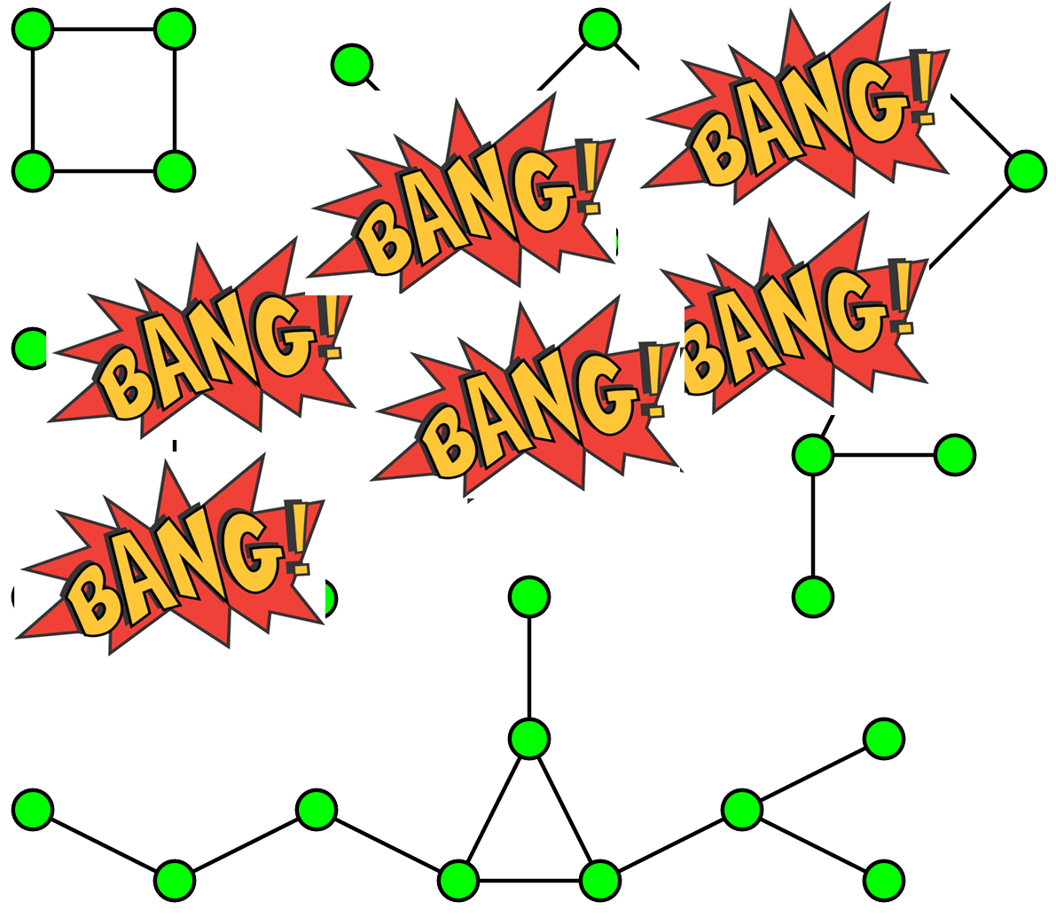
Interaction failure
@RudolfVesely

Slide 18

Interaction failure
@RudolfVesely

Slide 19
What is Pester?
Testing framework written in PowerShell
First open source community project in a production release of the MS OS (Win 10)
Used to test PowerShell core
@RudolfVesely

Slide 20
What to test?
Good candidates
Custom Modules
Custom Functions (Advanced Functions)
Custom Workflows
Custom DSC Resources
Anything else - for example OS
@RudolfVesely

Slide 21

Start an action…
@RudolfVesely

Slide 22
Next?
Mocking
Another abstraction on top of all Test.ps1 files
Custom module to do all tests
@RudolfVesely

Slide 23
Next?
Another testing level: “Ops” testing
Testing of OS configuration
Testing whether all components are healthy
@RudolfVesely

Slide 24

“Ops” testing
We all want clean Windows….
@RudolfVesely

Slide 25
Thank you
please Tweet: @RudolfVesely
and please send feedback: https://pollev.com/raxtech
Contact details
https://techstronghold.com/contact
https://twitter.com/rudolfvesely

